Slide 1
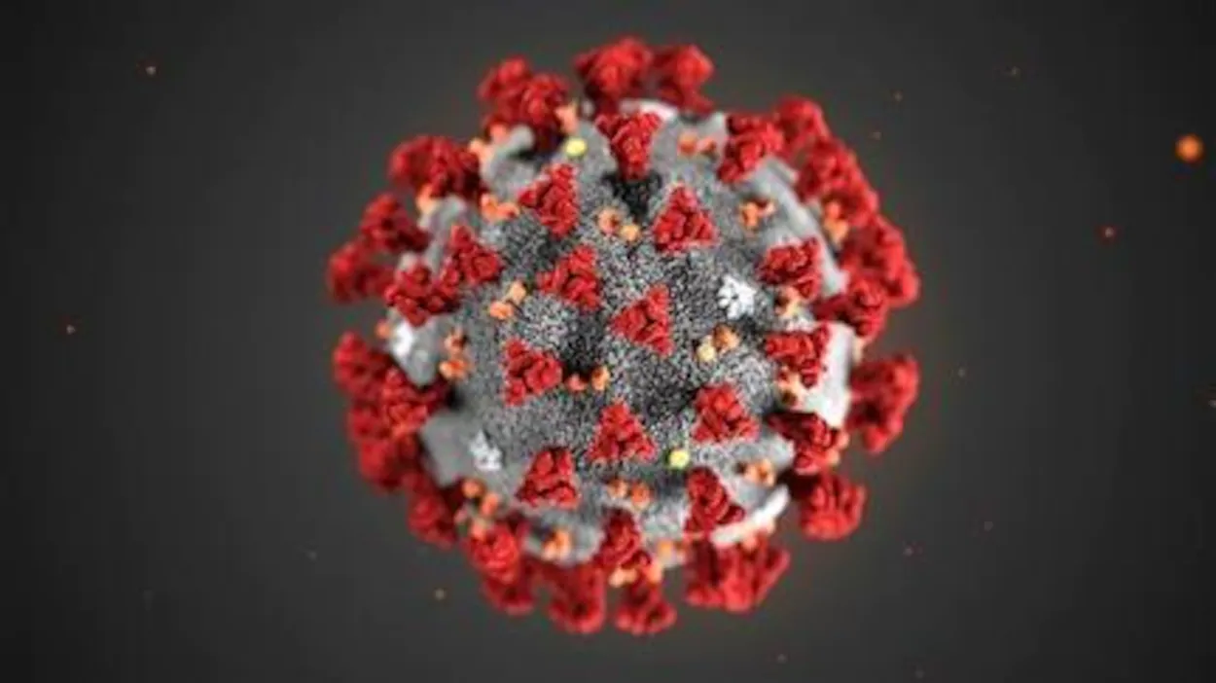
The COVID-19 pandemic
seen by a student in Signals, systems and BioEngineering – Vincent STRAGIER
Disclaimer: I’m not a doctor, so don’t take my words as the truth. If you feel yourself unwell, please seek for medical help (in Belgium, you can call the 1733 at any time).

Slide 2
Introduction
Why did I choose this subject?
What is the COVID-19?
What is the view of the media?
What the governments are doing?
Are we totally lost (#allgonnadie)?
The WHO plan
Playing with the COVID-19
Note: I’ll be talking a lot of the World Health Organization (WHO), for the French speakers, it’s the “Organisation Mondiale de la Santé (OMS)”.

Slide 3


Why did I choose this subject?
Biomedical
A lot of data
International
It’s a viral subject

Slide 4
What is the COVID-19?
“COVID-19 is the infectious disease caused by the most recently discovered coronavirus. This new virus and disease were unknown before the outbreak began in Wuhan, China, in December 2019.”, https://www.who.int/news-room/q-a-detail/q-a-coronaviruses (15 March 2020)

Slide 5
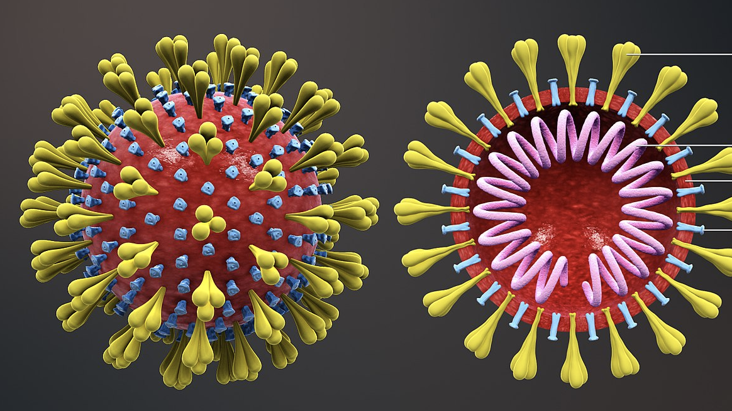
Corona what?
From the Latin word “corōna“ (“crown”).
Coronaviruses are therefore crown shaped viruses!
The virus is called the SARS-CoV-2
https://en.wiktionary.org/wiki/corona
https://www.who.int/news-room/q-a-detail/q-a-coronaviruses
https://www.who.int/emergencies/diseases/novel-coronavirus-2019/technical-guidance/naming-the-coronavirus-disease-(covid-2019)-and-the-virus-that-causes-it

Slide 6
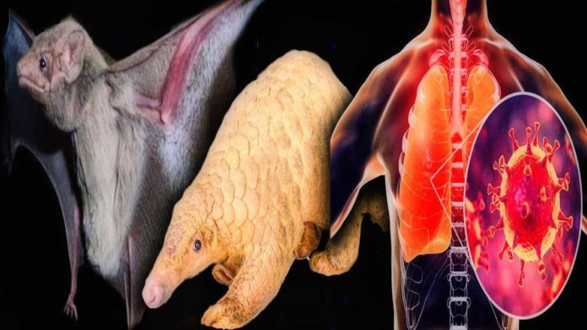
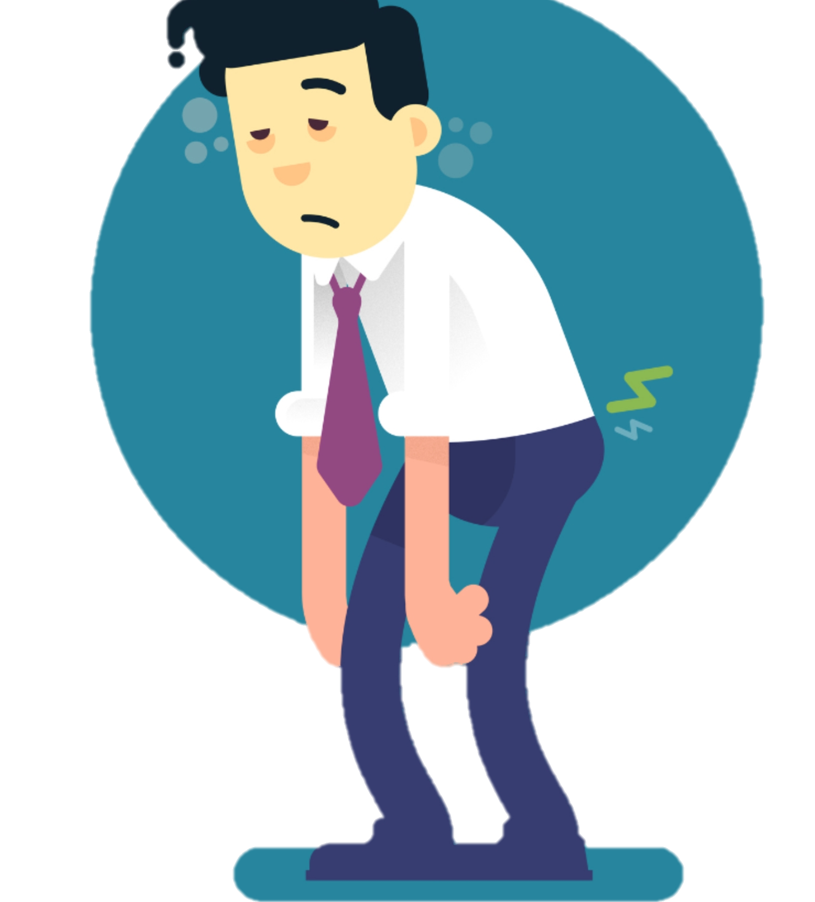
What are the symptoms “doctor WHO”?
The most common of the COVID-19:
Fever (87,9 %)
Tiredness (38,1 %)
Dry cough (67,7 %)
https://www.who.int/docs/default-source/coronaviruse/who-china-joint-mission-on-covid-19-final-report.pdf (page 11)
In 80 % of the cases, the disease is mild (2 weeks to recover), in less than 20 % of the cases, the disease is more severe (3 to 6 weeks to recover). And the crude death rate (number of deaths divided by the number of confirmed cases) is about 4 % (it’s not the fatality rate).
Most of the people contracting the disease are the care takers and the family members taking care of the ill people.
The best way to confirm a case of COVID-19 is the PCR analysis. (https://openwho.org/courses/introduction-to-ncov, Module B2)

Slide 7
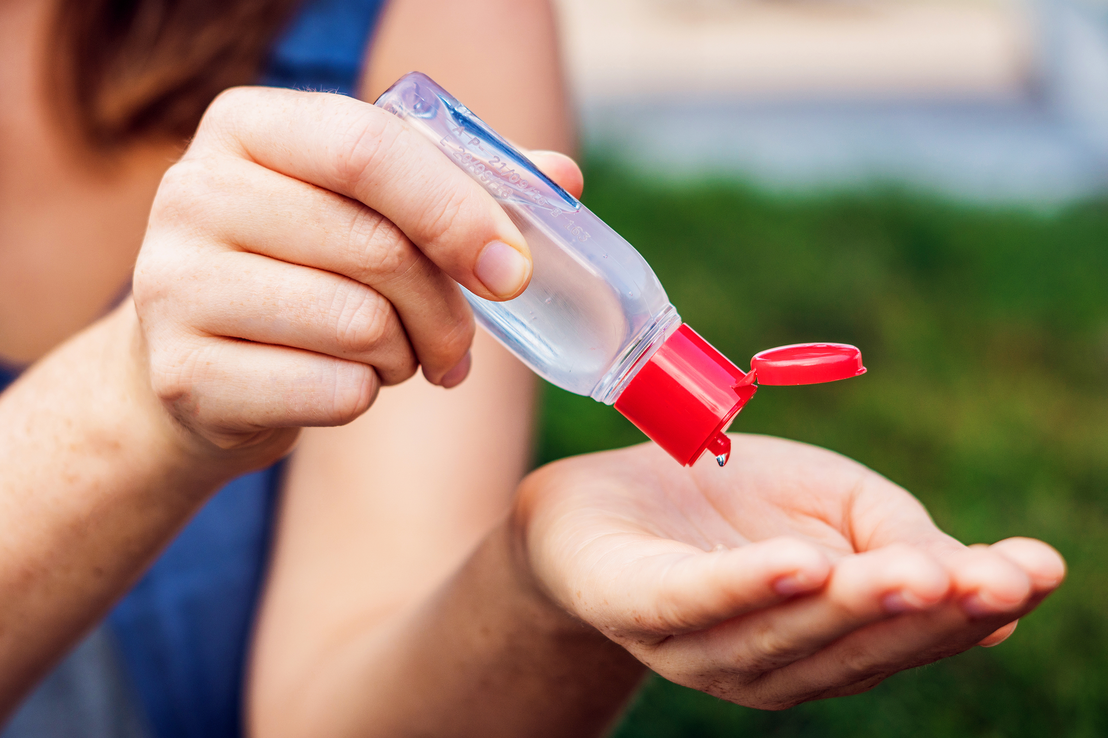
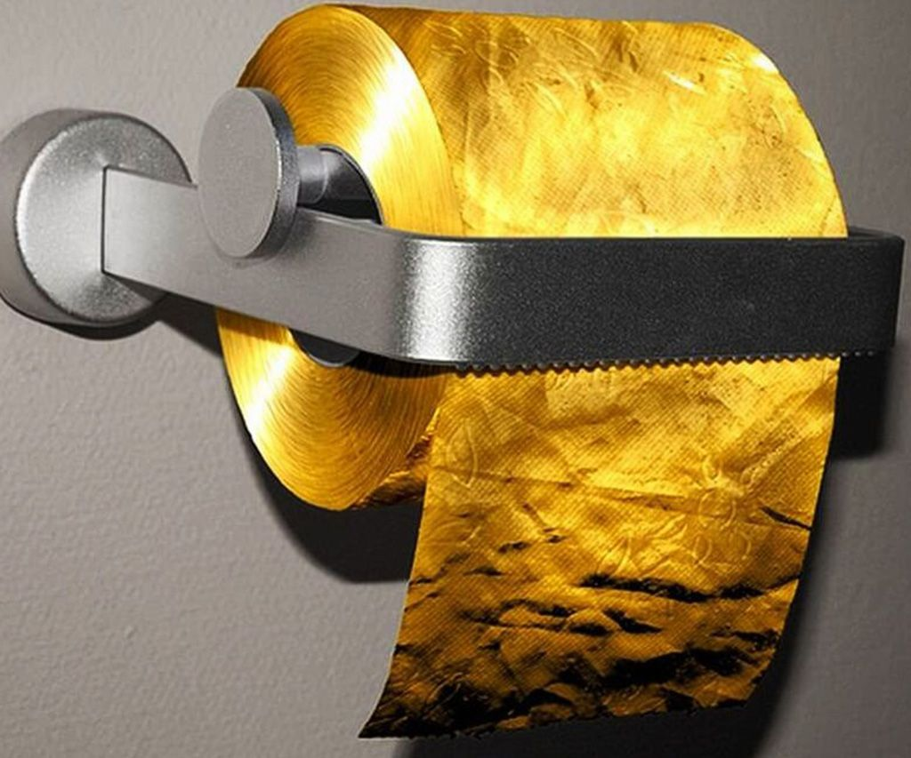
What is the view of the media?
In any country: daily reports about the international and sometime the national situation;
Bigger numbers before the facts;
Attractive titles:
https://www.rtl.be/info/belgique/societe/coronavirus-la-belgique-s-est-elle-bien-preparee-au-pic-de-cas-prevu-dans-quatre-semaines--1203010.aspx “Is Belgium prepared for the peak of [COVID-19] cases which will occurs in 4 weeks?”
https://www.rtbf.be/info/societe/detail_coronavirus-trois-medecins-specialistes-d-une-quarantaine-d-annees-dans-un-etat-grave?id=10458340 “[…] 3 specialised doctors […] contaminated and severely ill […]”
Most of the time we are not in front of specialists in the media, so avoid them as often as possible (if it gets you stressed, otherwise enjoy). Keep you informed from trusted sources:
https://www.info-coronavirus.be/en/ (website of the Belgian government)
https://www.who.int/emergencies/diseases/novel-coronavirus-2019 (the WHO website)
https://youtu.be/AwFTZawOc9k (don’t forget to be critic)

Slide 8
What the governments are doing?
Mostly trying to apply the strategy of the WHO in function of the nature of the cases:
In areas without cases;
In areas with sporadic cases;
In areas with community clusters;
In areas with community transmission.
https://www.who.int/docs/default-source/coronaviruse/who-china-joint-mission-on-covid-19-final-report.pdf (page 27)
Being harassed by the media (my opinion):
The Belgian government gives me the impression to reply to the demands of the media, more than to a real threat.

Slide 9
Is the outbreak real in Belgium?
YES
Since March the number or cases has increase (more than 1200 now):
Hundreds people coming back from Italy after the carnival’s holidays have been tested positive to the COVID-19.
Most of them have asked to be tested in Belgium before returning to Belgium.
At least 10 persons died due to the COVID-19
The 15th of March, 163 confirmed cases are hospitalised. In those 163 cases, 33 persons need a respiratory support.
https://www.info-coronavirus.be/fr/2020/03/11/premier-deces-lies-au-covid-19/
https://www.info-coronavirus.be/fr/2020/03/11/deux-nouveaux-deces-lies-au-covid-19/
https://www.lalibre.be/planete/sante/coronavirus-197nouveaux-cas-en-belgique-5e6de918f20d5a29c66aae0e

Slide 10
So what did the Belgian government?
Slow down the spread of the virus by observing the following advice:
Avoid shaking hands, kissing or cuddling the persons you meet
Pay a very special attention to people who are considered as being at risk, such as elderly people over 65, people with diabetes or with a heart, lung or kidney disease, babies up to 6 months, pregnant women, and people with a weakened immune system.
Children do not belong to those groups of people at risk, but they can easily transmit the virus. Therefore, it is recommended to avoid contacts between children and elderly people.
Try keeping a distance from others when you are in a crowded place.
Avoid contacts with persons who are visibly ill and keep a distance from them.
From: https://www.info-coronavirus.be/en/
More restrictive measures have been taken:
https://www.wallonie.be/fr/actualites/coronavirus-covid-19-ce-quil-faut-savoir#

Slide 11
Are we totally lost (#allgonnadie)?
Yes, we will probably all die.
But not all from the COVID-19.
https://github.com/2010019970909/COVID-19_graphs (code used to generate the graphs)
For sure, we are at the beginning of the outbreak.
A peak in 4 weeks?
I don’t know.
We are mostly testing severely ill people and medical staff in Belgium due to the lack of testing reactive.
https://www.rtbf.be/info/dossier/epidemie-de-coronavirus/detail_coronavirus-il-y-a-des-patients-pour-lesquels-les-tests-ne-seront-pas-realises?id=10450285

Slide 12
The WHO plan
“[…]
Not testing alone.
Not contact tracing alone.
Not quarantine alone.
Not social distancing alone.
Do it all. […]”, WHO Director
https://www.who.int/dg/speeches/detail/who-director-general-s-opening-remarks-at-the-mission-briefing-on-covid-19---13-march-2020
Reading this media briefing, we can notice that it should be more effective if the WHO had power on each government. This outbreak is not going to be stopped at the border (https://www.theguardian.com/australia-news/2020/mar/16/morning-mail-coronavirus-deaths-spike-in-europe-trump-criticism-truganinis-true-story)

Slide 13
Playing with the COVID-19 – The world
I am not going to lie, it’s still getting worst.
The yellow curve shows this increase of cases (people currently ill).
The green curve shows the recovered cases.
Note: As far as I know, I’ve not seen these curves in any media.
https://gisanddata.maps.arcgis.com/apps/opsdashboard/index.html#/bda7594740fd40299423467b48e9ecf6

Slide 14
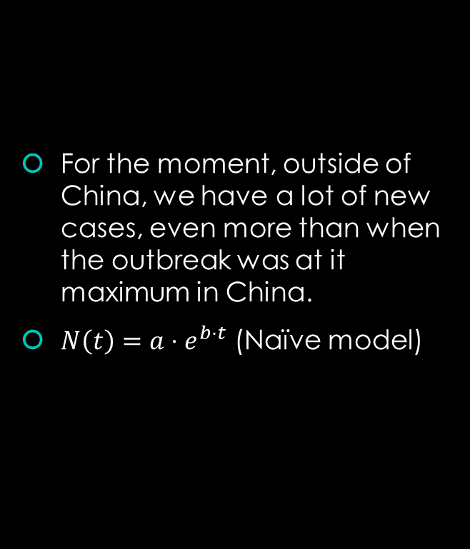
Playing with the COVID-19 – The world except China
For the moment, outside of China, we have a lot of new cases, even more than when the outbreak was at it maximum in China.
$N\left(t\right)=a⋅e^{b⋅t}$ (Naïve model)

Slide 15
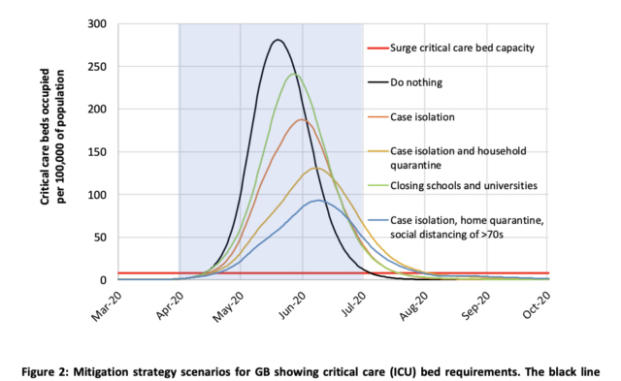
Playing with the COVID-19 – Parenthesis
https://arstechnica.com/science/2020/03/new-model-examines-impact-of-different-methods-of-coronavirus-control/

Slide 16
Playing with the COVID-19 – China
Did China cheat in its numbers before mid February?
No, the measuring methodology did change to take into account the clinical cases.
https://www.who.int/docs/default-source/coronaviruse/situation-reports/20200213-sitrep-24-covid-19.pdf?sfvrsn=9a7406a4_4
Since the 19th of February, China has reached its peak. It’s related to the measure took by the Chinese government to contain the outbreak.

Slide 17
Playing with the COVID-19 – Denmark
The Denmark applied some measures before Belgium and we can see it in the curve.
The growth rate did decrease.
Also since most of the cases will be in the medical staff and in the family we still have an evolution of the spread due to the household contamination, etc.

Slide 18

What to do now?
Keep practicing the individual measures (washing your hands, coughing or sneezing in your sleeve, avoid sick people, avoid to touch your face, etc)
https://www.who.int/emergencies/diseases/novel-coronavirus-2019/advice-for-public
Apply the social distancing as strictly as possible.
Stay in contact with your family and friends (by internet if you are not near them).
Try to keep a healthy lifestyle, avoid drugs, alcohol and smoking.
Keep you inform (look at the WHO website and your government website).
Limit your time watching the news or listening to the media.
Improve your skills.
https://github.com/2010019970909/COVID-19_graphs/blob/master/coping-with-stress.pdf
https://github.com/2010019970909/COVID-19_graphs/blob/master/gestion-du-stress_traduction_non_officiel.pdf

Slide 19
Some questions…
What are the major issues?
What should we fear?
What is your point of view regarding the solutions implemented?
Do you trust your government?
Do you trust the WHO?
Is China showing an example in the outbreak management and why?

Slide 20

Thank you all for your attention
*
*Unity makes strength

